Slide 1
Handling Data

Slide 2
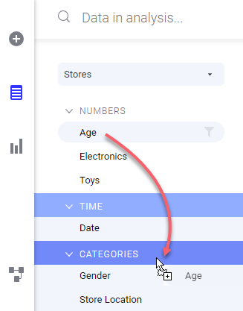
Data Types
The category of a column affects what happens when you drag the column to a column selector or to a drop target in a visualization.
It also affects which kinds of visualizations are advised in recommendations.
If the suggested category for a column is not your preferred category, you can change the categorization.
The different categories are Numbers, Currency, Time, Location, Categories, Identifiers, Text, Images, and Binary.

Slide 3
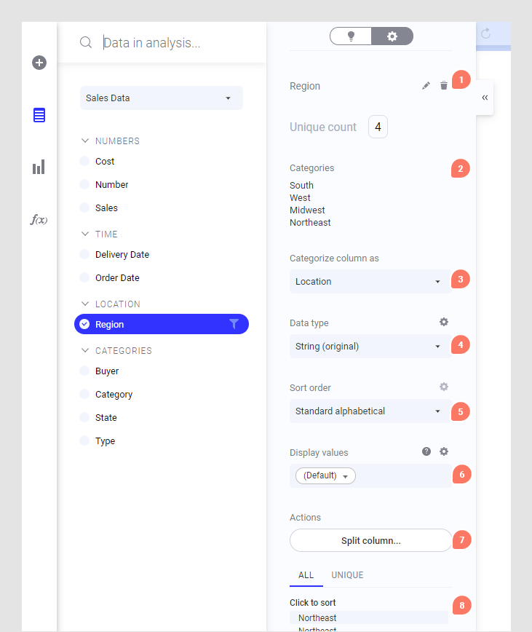
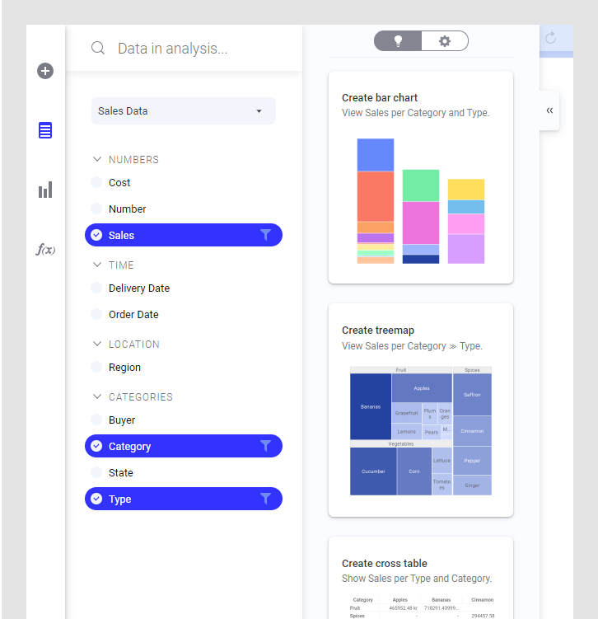
Data in Analysis Flyout
Details on Selected Column
Recommendations from selected columns

Slide 4
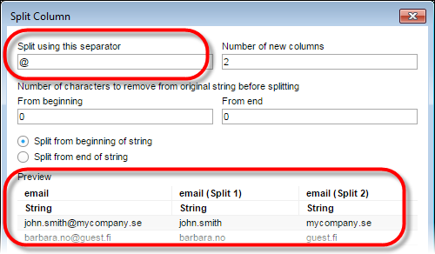
Data in Analysis Flyout – Splitting Columns

Slide 5
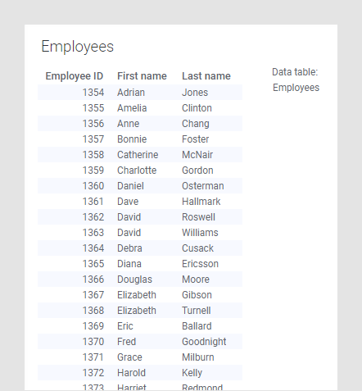
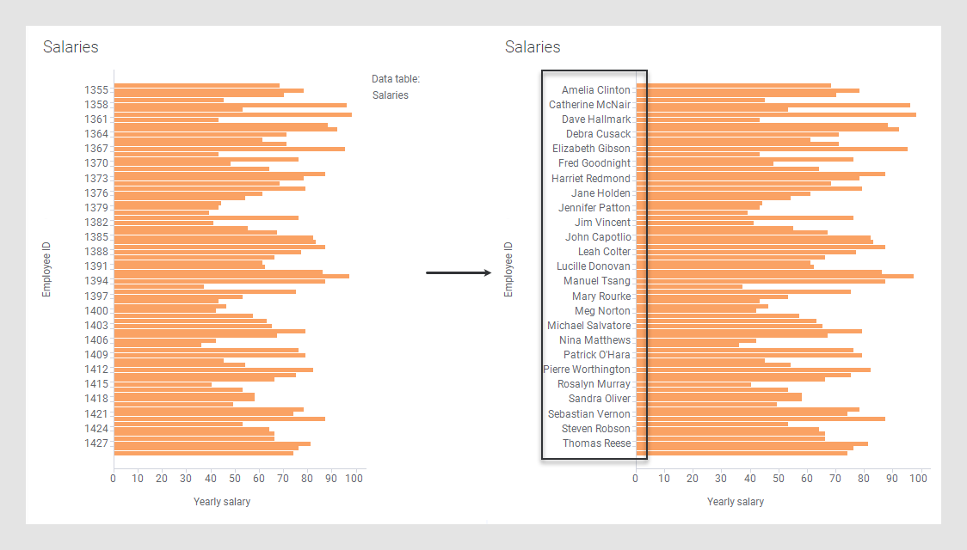
Data in Analysis Flyout – Custom Values
Concatenate([Employees].[First name]," ",[Employees].[Last name])

Slide 6
Data in Analysis Pop-up Menu
Data Tables
Columns
Option | Description
Rename... | Allows you to change the name of the selected data table.
Sort order | Changes the display of columns in the flyout. Choose from: Categorized, No sorting, Ascending or Descending views (and Hierarchical, for cube data).
Set as default data table | Sets the selected data table to be the default data table in the analysis.
Data table properties | Opens the Data Table Properties dialog where you can edit the properties of the data tables in the analysis, including relations across tables (internal and external).
Option | Description
Rename... | Allows you to change the name of the selected column. Note: The columns use the same name as their corresponding filters, so renaming a column will also change the filter name, if a filter exists for the column.
Delete | [Only available for in-memory data tables.] Deletes the selected columns from the data table.
Create filter | [Only available for columns which currently do not have a corresponding filter.] Creates filters for the selected columns.
Change categorization | Allows you to change the category for the selected column.
Geocoding | Allows you to find a geocoding hierarchy in the library and manually specify that a column should be used for geocoding.

Slide 7
Data in Analysis Flyout – Filter Transformation
Filtering out data using filters, or deleting marked rows, might sometimes not be permanent enough to remove unwanted data from your analysis, because reloading the data or resetting the filters might bring the undesired data back.
If you want to make sure that values gets permanently removed, you can instead add a Filter rows transformation.
In the Filters panel, or in the Data in analysis flyout, filter your data to include only what you want to keep in the analysis.
When you are done, right-click the filter and select Create Filter Transformation from the pop-up menu.

Slide 8
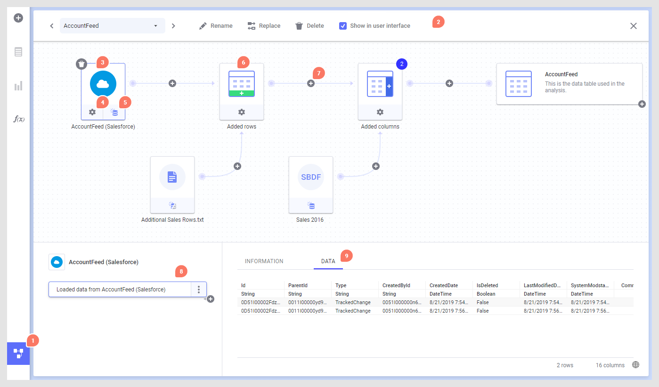
Data Canvas

Slide 9
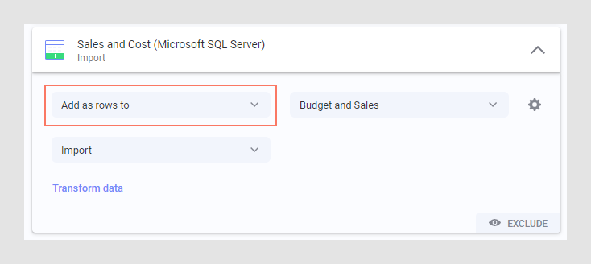
Data Canvas – Add Rows

Slide 10
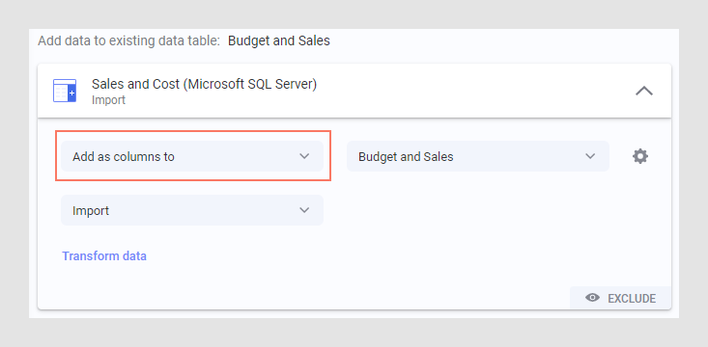
Data Canvas – Add Columns

Slide 11
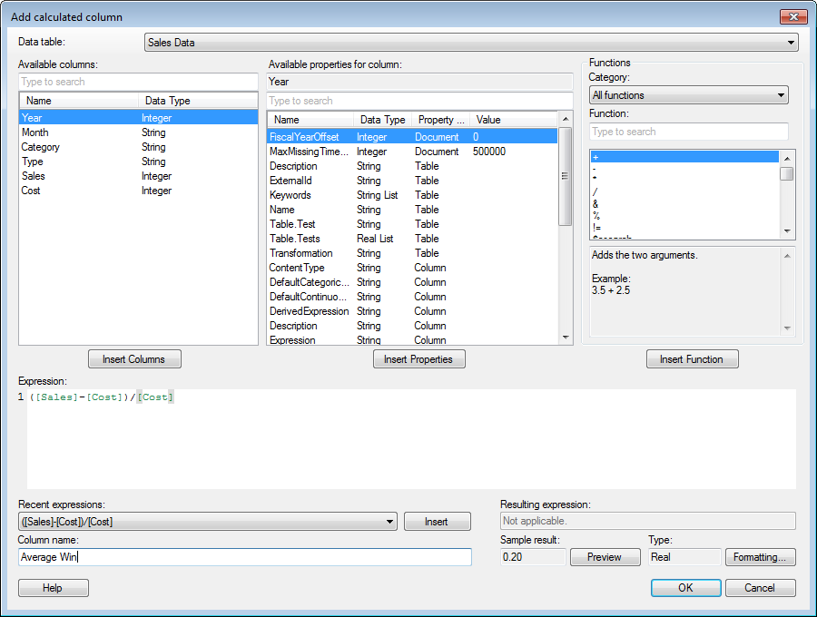
Data Canvas – Calculated Columns

Slide 12
Exercise
Using the data from NEISS (injuries.csv and products.csv) find:
What 3 demographic groups are more prone to injuries?
For each of the three groups above, which product category do the get hurt with?
Which 3 product categories cause more injuries in the population?

